Slide 1
Windows , Linux, Networking Fundamentals

Slide 2
OVERVIEW OF WINDOWS

Slide 3
OPERATING SYSTEM

Slide 4
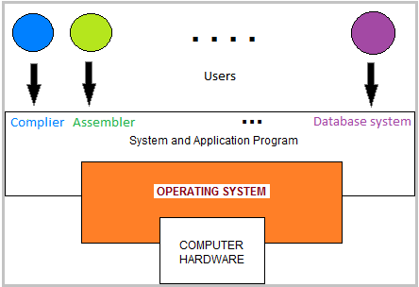
An operating system is an interface between a computer user and computer hardware.

Slide 5
Types of Operating Systems
Batch processing operating system
Real time operating system
Distributed operating system
Time sharing operating system
Network operating system
Multitasking operating system

Slide 6
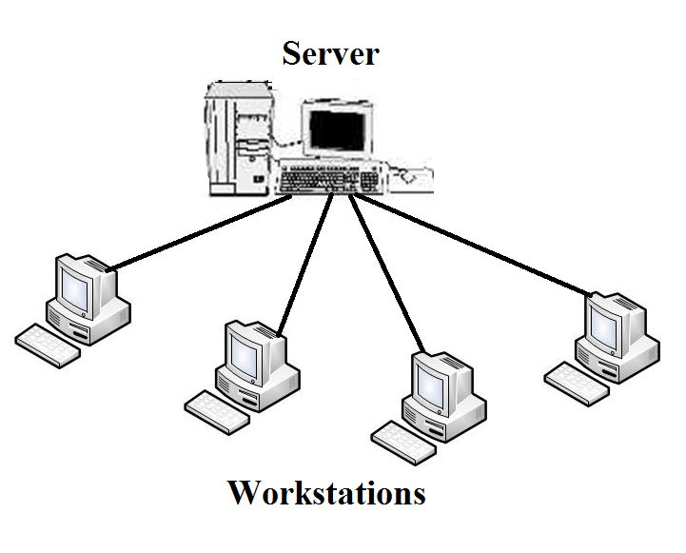
Workstation and Server
Workstation - Workstation is a device designed for high end applications.
Server - Server is an application or a device that provides services for connected clients.

Slide 7
KERNEL ARCHITECTURE

Slide 8
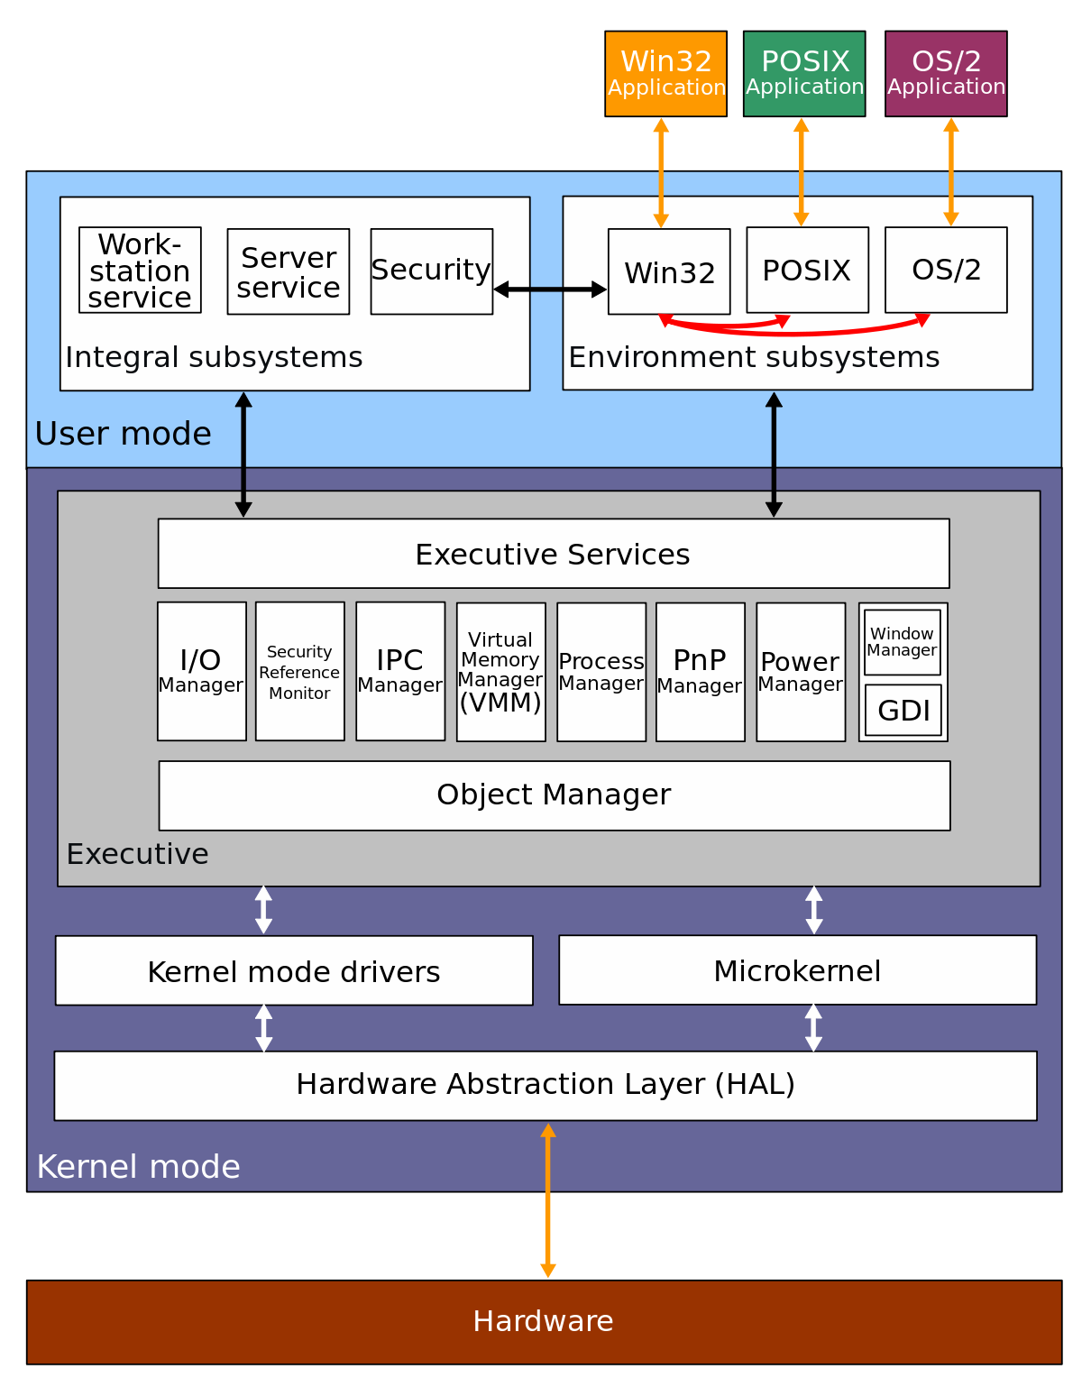

Slide 9
BOOTING PROCESS

Slide 10
BOOTING PROCESS- Windows
NTOSKRNL.EXE
WINLOGON.EXE
SMPS
HAL.DLL
BOOTVID.DLL
SYSTEM DRIVERS
REGISTRY
LOGINUI.EXE
BIOS (POST)
DWM.EXE
MBR
SMSS.EXE
CSRSS.EXE
USERINIT.EXE
BOOTMGR
WININIT.EXE
WINLOAD.EXE
EXPLORER.EXE
SERVICES.EXE
LSASS.EXE
SAM
MSGINA
WINRESUME.EXE

Slide 11
SAFE BOOT OPTION
Safe Mode
Safe mode with networking
Safe mode with command prompt
Last known good configuration
Start windows normally

Slide 12
FILE SYSTEM

Slide 13
Symbolic links and hard links
File System
Symbolic link is that contains a reference to another file or directory in the form of an absolute or relative path and that affects pathname resolution.
Hard link is a directory entry that associates a name with file on a file system.
File Attributes
Archive
hidden
System
Read-only
Compressed
Encrypted
Write

Slide 14
FAT
Designed for small disks and simple folder structure.
Two copies of the allocation table are stored on the volume. Suppose one gets corrupted other file allocation table is used.
A volume formatted with FAT is allocated in clusters.
Versions:
FAT12
FAT16
FAT32
ExFAT
Structure of FAT volume
Partition boot sector | Reserved sector | FAT1 | FAT2 | Root folder | Other Folder and file

Slide 15
NTFS
Versions
V1.1
V1.2
V3.0
V3.1
File size of NTFS is 16TB.
Secure-Encryption.
We can not convert NTFS to FAT32.
We can compress the files in it.
Supported by Windows vista, windows server 2003, windows 2000.

Slide 16
MANAGEMENT MECHANISM

Slide 17
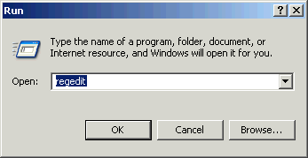
WINDOWS REGISTRY
The registry is a hierarchical database that stores low-level settings for the Microsoft Windows operating system and for applications that opt to use the registry. The kernel, device drivers, services, Security Accounts Manager (SAM) and user interface can all use the registry.

Slide 18
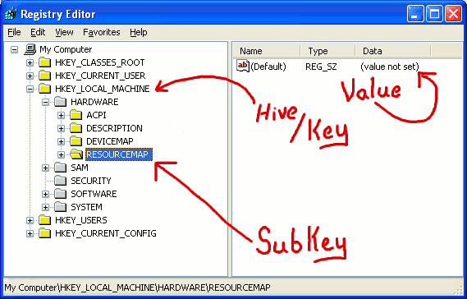
STRUCTURES IN REGISTRY
The registry contains two basic elements: keys and values.
Registry keys are container objects similar to folders.
Keys may contain values and subkeys.
Registry values are name/data pairs stored within keys.
A hive is a logical group of keys, sub keys, and values in the registry.
There are five hives of the registry:
HKEY_LOCAL_MACHINE or HKLM
HKEY_CURRENT_CONFIG or HKCC
HKEY_CLASSES_ROOT or HKCR
HKEY_CURRENT_USER or HKCU
HKEY_USERS or HKU

Slide 19
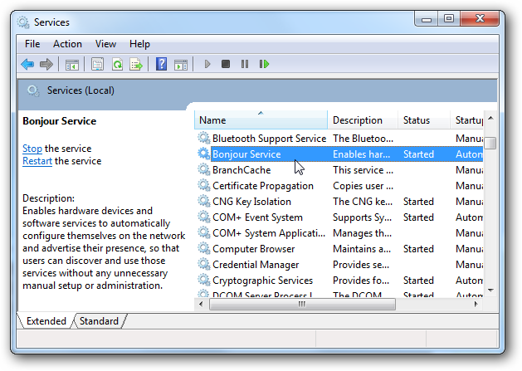
SERVICES
A Windows service is a computer program that operates in the background.

Slide 20
DEVICE MANAGEMENT

Slide 21
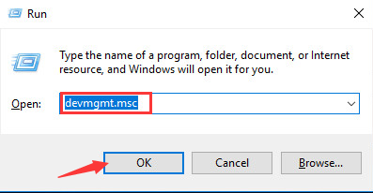
DEVICE DRIVERS
A device driver is a computer program that operates or controls a particular type of device that is attached to a computer.
A device controller is a part of a computer system that makes sense of the signals going to, and coming from the CPU.

Slide 22
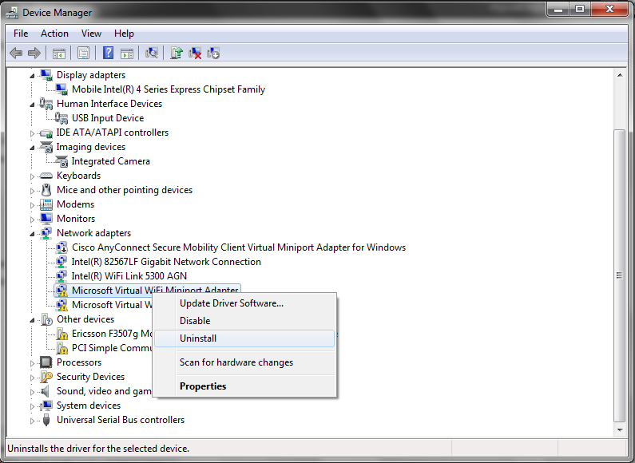
HOW TO INSTALL,UNINSTALL AND UPDATE DEVICE DRIVER?

Slide 23
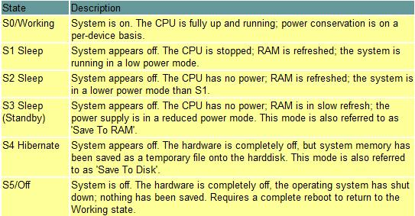
POWER STATES

Slide 24
PROCESS MANAGEMENT

Slide 25
Process Management
Process
A process is an executing program.
One or more threads run in the context of the process.
Threads
A thread is the basic unit to which the operating system allocates processor time.
A thread can execute any part of the process code, including parts currently being executed by another thread.

Slide 26
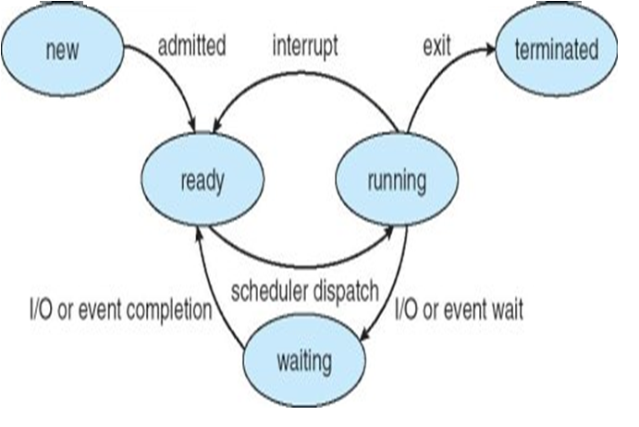
Process States
Processing Types
Multiprocessing
Multitasking
Multithreading
Multiprogramming

Slide 27
MEMORY MANAGEMENT

Slide 28
VIRTUAL MEMORY
Virtual Memory is a storage allocation scheme in which secondary memory can be addressed as though it were part of main memory.
Working Set : Amount of physical memory currently used by the process is called working set.
Private Working Set
Sharable Working Set
Working Set = Private Working Set + Sharable Working Set
The total amount of virtual address space available to a process is limited by physical memory
Physical storage and the virtual address space of each process are organized into pages

Slide 29
PAGING
Paging is a memory management scheme by which a computer stores and retrieves data from secondary storage for use in main memory.
Operating system retrieves data from secondary storage in same size blocks called pages.

Slide 30
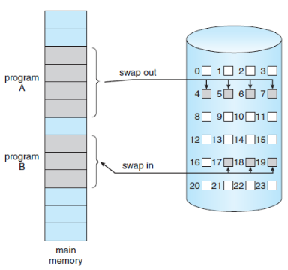
PAGE STATE SWAPPING
Free | The page is neither committed nor reserved. The page is not accessible to the process
Reserved | The page has been reserved for future use.
Committed | The page is accessible

Slide 31
FRAGMENTATION
As processes are loaded and removed from memory, the free memory space is broken into little pieces. It happens after sometimes that processes cannot be allocated to memory blocks considering their small size and memory blocks remains unused. This problem is known as Fragmentation.
Fragmentation is of two types −
External fragmentation
Total memory space is enough to satisfy a request or to reside a process in it, but it is not contiguous, so it cannot be used.
Internal fragmentation
Memory block assigned to process is bigger. Some portion of memory is left unused, as it cannot be used by another process.

Slide 32
MEMORY POOL
Memory pools
fixed-size blocks allocation is the use of pools for memory management that allows dynamic memory allocation
Non-paged pool
2. Paged pool

Slide 33
LINUX

Slide 34
NETWORK FUNDAMENTALS

Slide 35
Communication over network
Data communication refers to the transmission of this digital data between two or more computers and a computer network or data network is a telecommunications network that allows computers to exchange data.
The devices that transmit or receive this data, such as a phone or a computer.
Examples:
Whats App
Mobile Communication

Slide 36
Quality of network communication
Quality of service (QoS) is the description or measurement of the overall performance of a service, such as packet loss , bit rate, throughput , transmission delay, availability, , jitter etc.

Slide 37
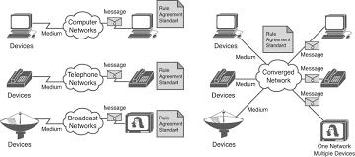
Converged Network

Slide 38
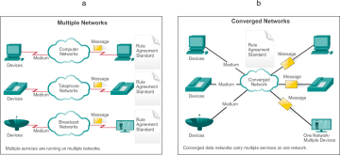

Slide 39
Advantages of Networking
File sharing – you can easily share data between different users, or access it remotely if you keep it on other connected devices.
Resource sharing – using network-connected peripheral devices like printers, scanners and copiers, or sharing software between multiple users, saves money.
Sharing a single internet connection – it is cost-efficient and can help protect your systems if you properly secure the network.
Increasing storage capacity – you can access files and multimedia, such as images and music, which you store remotely on other machines or network-attached storage devices.

Slide 40
Thank you

